Slide 1

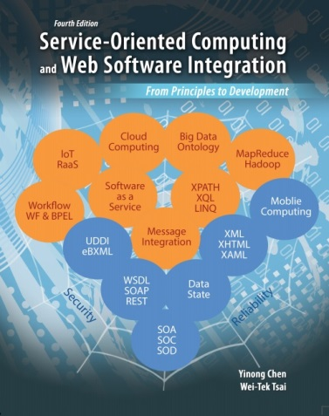
Chapter 6 Security and Reliability of Distributed Software and Systems
Lecture 22
General Security and Reliability Concepts
Text Chapter 6.1
Yinong Chen

Slide 2
Roadmap of Chapter 6
General Security & Reliability Concepts (Text Section 6.1)
IIS and Windows-Based Security Mechanism
Forms-Based Security and Case Study (Text Section 6.2)
Error Control in communication and Secure Socket Layer for Secure HTTP Connection
Data Encryption and Decryption
Reliability and Security in Windows Communication Foundation
L23
L24
L25
L26

Slide 3
Organization of SOC-Enabling Technologies
Technologies supporting the functionality
Workflow and Composition
Quality of Service
Service Broker
Service
Description
Data/Knowledge
Description
Service
Protocols
Data/Knowledge
Organization
Cloud Computing
Management
Policy Exchange
Introspection
Coordination & Transaction
Message Correlation
Reliability
Service Implementation and
Development Platforms
Security
Data and Resource Representation
Infrastructure
Computing and Communication Resources
Dependability of Service

Slide 4
Instances of the SOC-Enabling Technologies
User’s perspective
Technologies supporting the functionality
C#, Java, BPEL, BPSS, OWL-S,
PSML-S, WS-DCL, VPL
Quality of Service
UDDI / ebXML
WSDL
Hadoop, RDF, Prolog, OWL
SOAP,
HTTP
Big Data/Ontology and Frameworks
AWS Cloud Computing, Google App Engine,
IBM Clouds, Microsoft Azure,
WS Management
WS-Policy Exchange
WS-Coordination, WS-Transaction
WS-Reliable Messaging
WS-inspection
WS-Security
WS-Addressing
C#, C++, Java, VB
Eclipse, Visual Studio
XML, URI, Unicode
ESB, Intel SOI, Virtualized Devices
Dependability of Service
Designer perspective

Slide 5
Quality of Service (QoS)
User’s perspective
ISO 8402 [ISO, 1986] defines quality as "the totality of features and characteristics of a product or service that bears on its ability to meet a stated or implied need".
Different fields have different measurable interpretations:
Network quality: represents the transmission rates, error rates, and other characteristics that can be measured, improved, and to some extent, guaranteed in advance.
Software quality: is the degree to which software conforms to quality criteria. Quality criteria, some are measurable and some are not, include:
Economy, Correctness, Resilience, Integrity, Reliability,
Usability, Modifiability, Clarity, Understandability, Validity, Maintainability, Flexibility, Generality, Portability, Interoperability, Testability, Efficiency, Modularity, Reusability

Slide 6
Dependability Concept and Terminology
Safety
Vulnerability
What to measure
Confidentiality
Security
Attributes
Data integrity
How to improve, measure, and guarantee
Reliability
Availability
Maintainability
Software
Hardware
Network
Prevention (Methodology)
Dependability
Means
Tolerance (Redundancy)
Removal (Testing)
Sources of problems
Forecasting (Modeling)
Attack (malicious)
Trustworthiness
Fault (defect, bug)
Impairments
Error (Manifestation of fault/attack)
Failure (impact on output)
Business Integrity
Dependability
Reliability
Designer perspective
Reliability function R(t)

Slide 7
Measurable Failure Probability and Reliability Function
Let T be a random variable that represents the time interval from time 0 to the time of the first failure’s occurrence.
The Function: F(t) = Prob[T ≤ t] is called failure probability in the interval [0, t].
Reliability ensures continuity of service in [0, t].
R(t) function of a system is the probability that the system has survived in the time interval [0, t], given that it is operational at time 0.
R(t) = 1 – F(t) = 1 – Prob[T ≤ t] = Prob[T > t]
Availability ensures the readiness of service at time point t.
A(t) function of a system is the probability that the system is working at time t.

Slide 8

Measurable R(t), A(t) and MTTF (Mean Time To Failure)
For a failure rate λ = 10⁻⁴/hour, R(t) = e^{-λt} , MTTF = 1/λ = 10⁴ hours
For a repair rate μ = 10⁻³/hour,
If μ = 0, R(t) = A(t) , and if t → ∞,
1
0.9
0.8
A(t)
0.7
0.6
R(t)
Probability
0.5
0.4
0.3
MTTF
0.2
0.1
0
0
1000
2000
3000
4000
5000
6000
7000
8000
9000
10000
11000
12000
13000
14000
15000
16000
17000
18000
19000
20000
Time in Hours

Slide 9
Security: Vulnerability, Confidentiality, Integrity, and Safety
Vulnerability describes a problem or weakness, such as a programming error or common misconfiguration, that allows a system to be attacked or broken into.
Confidentiality ensures that information is accessible only to those authorized to have access.
Data/Message integrity refers to the validity and consistence of data/message. We also use provenance for the traceability of data – where and how does the data come from?
Safety ensures non-occurrence of catastrophic consequence on the environment (human life lost, economic impact, etc.)
Security is the umbrella concept of above four.
Security deals with malicious attacks, while reliability and availability deal with faults, errors, and failures caused by imperfect development and operation environment.

Slide 10
Web Attacks, Security Attributes, and Means,
Web Application Security

Slide 11
Common Attacks on the Web
What Web computing model can cause this attack?
What technique can prevent this attack?
Attack | Description
Cross-site scripting (XSS) | Script programs are used as input data and are executed in browser on client side.
Denial of service (DoS) | The attacker floods the network with fake requests, overloading the system and blocking regular traffic.
Eavesdropping | The attacker uses a sniffer to read unencrypted network packets as they are transported on the network
Rootkit and hidden-field tampering | The attacker compromises unchecked (and trusted) hidden fields stuffed with sensitive data in the Web forms
One-click | Malicious HTTP posts are sent via script: Do not click on suspicious links!
Session hijacking | The attacker guesses or steals a valid session ID and connects over another user’s session.
Database query / SQL injection | The attacker uses a malicious input string, e.g., a user name, that happens to form dangerous SQL commands, or an illegal character that triggers an unexpected operation. When it is sent to the DB for verification, it becomes a command.
Strong password

Slide 12
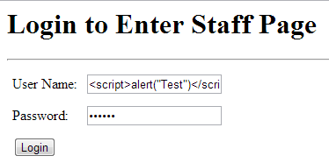
XSS Attack Example
A script is used as input data, which can be executed, if not programmed properly, in the browser.
Attack sequence
Script code is entered here
Script code is entered here
If the error message: The user name cannot contain special character, then …
View Page Source: If the input check is done in client-side script, modify the script to turn off the input check.
Another way of adding the script is to intercept the SOAP message and inject script into SOAP body.
Create a new page based on the modified page source, and enter script <script> … </script> again.

Slide 13
SQL Injection Attack
Similar to XSS attack, an attacker enters user name and password with SQL commands, such as SELECT, CREATE, UPDATE, DELETE, and INSERT.
When the system sends the user name and password to the database to check if the user name and password exist, the SQL commands are sent and executed instead.

Slide 14
Security Means and Attributes
Authentication requires an entity to present proof of identity and verify: Are you who you say you are?
Authorization confirms that an entity is entitled to access a resource: What are you allowed to do, after you are confirmed who you are?
Cryptography for
Message confidentiality ensures that only the intended recipient of a message can see the message in its original form
Message/Data integrity ensures that a message is not tampered with in transit or in storage

Slide 15
A Few Basic Concepts in Security
Credential: Evidence or information that provides proof of identity, such as a birth certificate or business license. A credential contains a claim, which provides information about a person or an entity, such as an account name or an e-mail address. Claims are certified by a trusted party called an issuer.
Entity: Something that possesses credentials, such as a person, an organization, a computer, or a session.
Resource: Something an entity might want to access, such as a page, a file, a database, a service, or an operation.
Security token: A representation of a credential that can be passed as part of a message, such as user name and password, encrypted or not.

Slide 16
Cryptography Systems
Secret key systems: A secrete key is used to encrypt the data/message
For example: cipher encryption adds an integer (key) to each character;
Problem: How can you safely transfer the key to the receiver through Web/internet?
Public Key Infrastructure: two keys are created.
Encryption for data confidentiality: An open key E for encoding, and a private key D for decoding. Reverse: It is exponentially complex to obtain D from E
Digital signature: An open key D for decoding and a private key for encoding. Reverse: It is exponentially complex to obtain E from D.
Other reverse example: Solving an equation system can be complex, but verify a solution is simple.

Slide 17
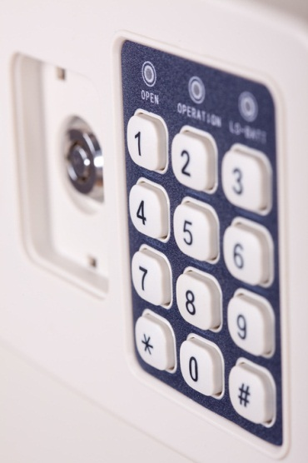
Analogy of Public Key Infrastructure
Consider a special safe box, which requires a key to open and a different key to lock.
Data confidentiality: You want to send a confidential document to your bank. You order a safe box from the bank, with a public key for locking. The key is printed on the box: 1234. You put the document in the safe box. Lock the safe box using key 1234, and mail the safe box to the bank. Only the bank has the key to open the safe.
Digital signature: The government sends an important announcement to the citizens, e.g., evacuation. The government puts the announcement in the box, locks it using a private key, and sends it to the citizens. The unlocking key is open and printed on the box:1234.
1 2 3 4

Slide 18
Public Key Encryption for Confidentiality
Public Key
Encryption System
Public key
1234
Key
Making
Encryption
Decryption
Private key
Public key
Private key

Slide 19
Example: Public Key Encryption for Confidentiality
Bank
Bank’s
Web site
3
New pwd
1
Key
acquiring
2
4
4
SSL Encryption
2
SSL
Decryption
Bank Customer
New pwd
5
7
6
010100101011010101

Slide 20
Public Key Encryption for Integrity -- Digital Signature
Public Key
Encryption System
For Confidentiality
Public key
Key
acquiring
Encryption
Decryption
Private key
Public key
Private key
For Data Integrity
Public Key
Encryption System
Public key
Key
acquiring
Encryption
Decryption
Private key
Private key
Public key

Slide 21
Example: Public Key Encryption for Integrity
Government, Lottery Authority
Government’s
Web Page
1
Key
acquiring
2
Decrypt
/ Verify
signature
2
5
Encryption
6: Yes
5
3 you win lottery
signature
5
you win lottery signature
4
Citizen

Slide 22
Security Mechanisms Related to ASP .Net
IIS Security Mechanisms
Windows Security Mechanisms
ASP .Net User-Defined Forms Security Mechanisms
inetinfo.exe
Aspnet_wp.exe
Browsers
IIS
ASP.Net
Application
domain
Forms Security
Application
domain
Forms Security
Aspnet_isapi.dll
Named
pipe
Application
domain
Forms Security
Windows or Windows Sever

Slide 23
Security Checks
Client Browser
IIS
IP address and domain permitted?
No
Yes
“None”
Check Web.config
token
token
“Forms”
“Windows”
ASP .Net
No
No
Windows authentication successful?
Forms authentication successful?
Yes
Windows Sever
Yes
No
Impersonation enabled
?
No
Other resource allowed?
Use impersonated account
Use configuration account
Yes
Access Allowed
Access Denied

Slide 24
IIS Security
Web applications are deployed in virtual directories that are URL-addressable on the server. Remote clients can’t access files outside virtual directories.
IIS supports IP address and domain name restrictions, enabling requests to be granted and denied based on the IP address or domain of the requestor.
IIS supports encrypted HTTPS connections using the Secure Sockets Layer (SSL) family of protocols.
SSL doesn’t protect resources on the server,
It prevents eavesdropping on conversations between Web servers and remote clients
IIS creates for every request an access token (security token).
The access token enables ASP.Net or the Windows/sever or ASP .Net Forms to perform ACL (Access Control List) checks on resources targeted by the request.
Each file can be given an access group (anonymous or with credential)
If the request runs as Bob and Bob isn’t allowed to read Staff.aspx, the request will fail when it attempts to read Staff.aspx.
IIS makes Bob’s access token available to OS or ASP.NET so that ASP.NET can perform access checks of its own.

Slide 25
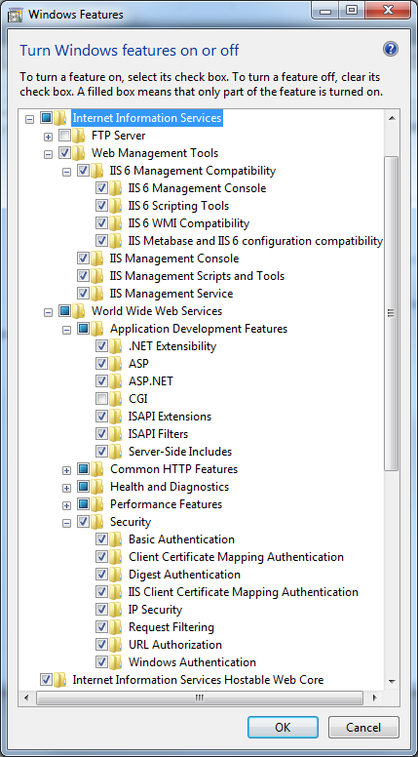
Turn on IIS
Turn on your IIS: Control Panel → Programs → Programs and Features → Turn Windows Features on or off

Slide 26
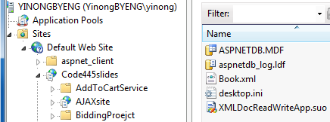
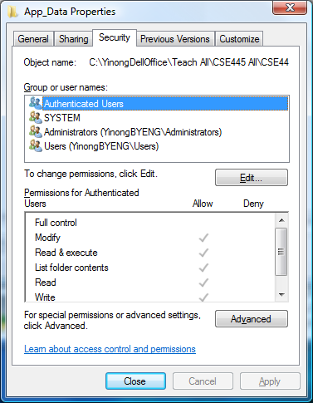
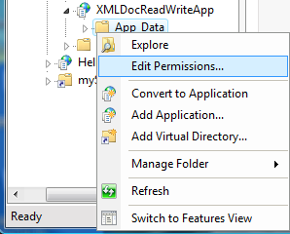
Configure Your IIS Security in Control Panel (Windows 7)

Slide 27
Using Windows Security System A Case Study
Partly from: Jeff Prosise, Programming Microsoft .Net, Core Reference, Microsoft Press.
Combining ASP .Net (Web.config), IIS (as the entry point, always needed), and Windows Security Mechanisms

Slide 28
Outline
General Security & Reliability Concepts (Text Section 6.1)
IIS Roles and Windows-Based Security Mechanism
Case Study: Windows-Based Security and Deployment
Forms-Based Security Creating an independent security system for Web access control and resource authorization (Text Section 6.2)
Secure Socket Layer for Secure HTTP Connection
Reliability and Security in Windows Communication Foundation
Data Encryption and Decryption

Slide 29
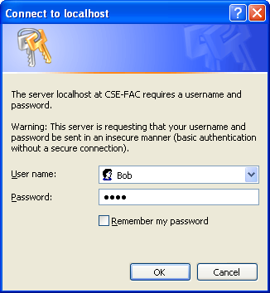
Using Windows Security
Anonymous: No access control
Windows authentication: Use Windows login credential to authenticate users
Basic authentication
Use user name and password to authenticate users
Password is sent in clear text
Digest authentication
Password is sent in encrypted text
Windows authentication is widely used in corporate network or intranet access

Slide 30
Case Study: Corporate Network Security
CorpNet: A Web Application models a simple corporate Intranet application;
It uses Windows authentication and program the authorization in C# to restrict access;
It consists of the following pages & files
General.aspx, which provides general information about the company; Anyone can see this page.
Salaries.aspx, which lists the salary of the employee; Restricted access.
Duties.aspx, which accesses the Duties.xml file; Restricted access.
Duties.xml, which lists the current employee duties. Restricted access to outsider.
Web.config file

Slide 31
General.aspx File
<%@ Page Language="C#" %>
<html>
<body>
<h1>Welcome to CorpNet!</h1>
<hr>
Welcome to the corporate intranet! We know who you are because you had to provide a user name and password to see this page. To prove it, your user name is shown below.<br>
<h3>
<%
if (User.Identity.IsAuthenticated)
Response.Write (User.Identity.Name);
%>
</h3>
</body>
</html>
Call Windows authorization mechanism based on the Windows accounts.
If true, print user name.
What Web computing model is used?
Client side scripting
Server-side scripting
Server-side code behind page

Slide 32
Salaries.aspx File: Authorization Control
To test the program, you may change one of the names, e.g., jeff, to your own login name on your computer. When the login window pops up, you can type your own login name and password
<%@ Page Language="C#" %>
<html>
<body> <h1>Salaries</h1> <hr>
<%
if (!User.Identity.IsAuthenticated)
Response.Write ("Sorry, but no salary information " +
"is available for unauthenticated users.");
else {
if (User.Identity.Name.IndexOf ("Jeff") != -1) Response.Write ("Jeff's salary is $650,000.");
else if (User.Identity.Name.IndexOf ("Ryan") != -1) Response.Write ("Ryan's salary is $60,000.");
else if (User.Identity.Name.IndexOf ("Bob") != -1) Response.Write ("Bob's salary is $30,000.");
else if (User.Identity.Name.IndexOf ("Julia") != -1) Response.Write ("Julia's salary is $70,000.");
else if (User.Identity.Name.IndexOf ("Mary") != -1) Response.Write ("Mary's salary is $45,000.");
else Response.Write ("No salary information is available for " + User.Identity.Name);
}
%>
</body>
</html>
Are we using policy-based computing?
How can we make it policy-based computing?
Use this piece of C# script to define the access privilege of each user.

Slide 33
Duties.aspx File
<%@ Import Namespace="System.Data" %>
<html>
<body>
<asp:DataGrid ID="MyDataGrid" Width="40%" RunAt="server" />
<asp:Label ID="Output" RunAt="server" />
</body>
</html>
<script language="C#" runat="server">
void Page_Load (Object sender, EventArgs e) {
try {
DataSet ds = new DataSet ();
ds.ReadXml (Server.MapPath ("Duties.xml"));
MyDataGrid.DataSource = ds;
MyDataGrid.DataBind ();
}
catch (Exception) {
Output.Text =
"An error occurred processing this page";
}
}
</script>
Load the XML file into a DataSet structure, which is a set of tables.
See chapter 5
If impersonate in Web.config is properly set, unauthenticated user cannot access the file even through a program

Slide 34
Duties.xml
<?xml version="1.0" encoding="UTF-8" ?>
<Duties>
<Duty>
<Name>Julia</Name>
<Portfolio>Security Manager</Portfolio>
</Duty>
<Duty>
<Name>Bob</Name>
<Portfolio>Contractor Manager</Portfolio>
</Duty>
<Duty>
<Name>Jeff</Name>
<Portfolio>Architect</Portfolio>
</Duty>
<Duty>
<Name>Ryan</Name>
<Portfolio>International Collaboration</Portfolio>
</Duty>
<Duty>
<Name>Mary</Name>
<Portfolio>Business Manager</Portfolio>
</Duty>
</Duties>
In this implementation, an authenticated user will see all the Duties.

Slide 35
Windows-Based Security Deployment and Testing
Create a directory named Basic somewhere — anywhere — on your computer, e.g., C drive.
Use the IIS configuration manager to create a virtual directory named “Basic” and link it. How? See next page.
While in the IIS configuration manager, configure Basic to require basic authentication and to disallow anonymous access. How?
Right-click Basic in the IIS configuration manager and select Properties from the ensuing context menu.
Go to the Directory Security page of the property sheet that pops up and click the Edit button under “Anonymous access and authentication control.”
In the ensuing dialog box, uncheck “Anonymous access” and check “Basic authentication”.
Right click the folder to convert the folder into application
OK the changes, and then close the configuration manager

Slide 36
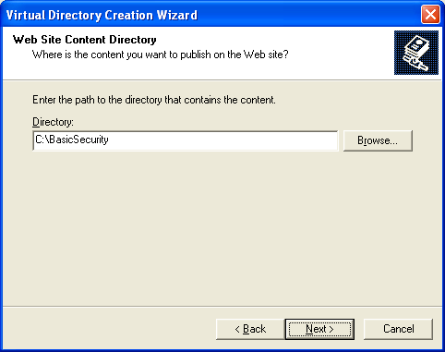
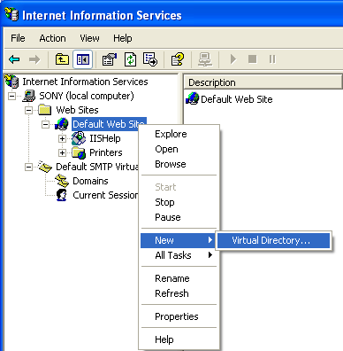
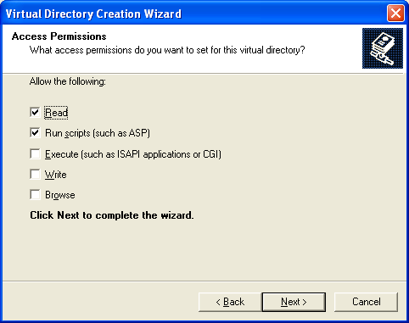
Creating a Virtual Directory in IIS
Browse to
Right click

Slide 37
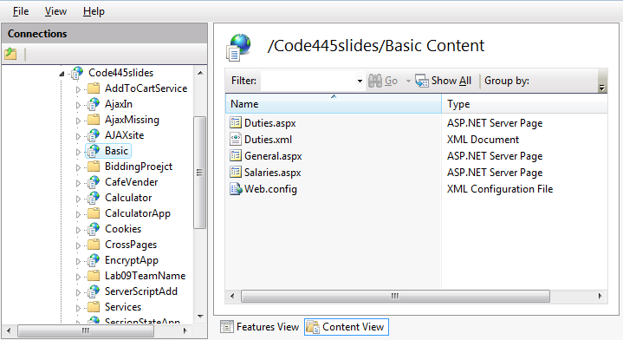
A directory BasicSecurity is created in IIS

Slide 38
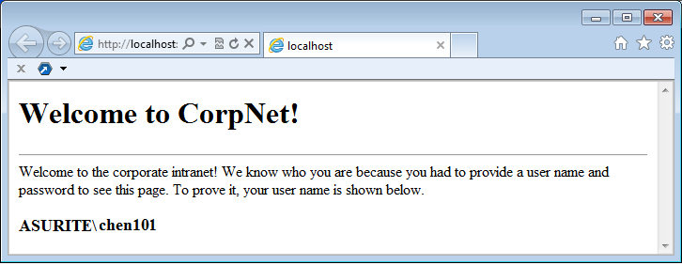
Creating the Authentication (contd.)
Create user accounts on your Windows for testing purposes, e.g., “Bob”, “Jeff”, “Julia”, …
Change the permissions on Salaries.aspx by removing the Anonymous access. See next page
Type http://localhost/Basic/General.aspx into your browser’s address bar to call up General.aspx. You will see the page, because, by default, it allows anonymous access.
http://venus.eas.asu.edu/wsrepository/BasicSecurity/General.aspx
if (User.Identity.IsAuthenticated)
Response.Write (User.Identity.Name);

Slide 39
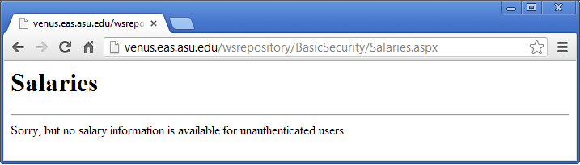
Creating the Authentication (contd.)
7. Type http://localhost/Basic/Salaries.aspx into your browser’s address bar. A dialog box will pop up, because the Salaries.aspx requires callers to be authenticated using basic authentication. Enter Bob’s user name and password.
Version deployed to ASU Repository
http://venus.eas.asu.edu/wsrepository/BasicSecurity/Salaries.aspx

Slide 40
Access Salaries.aspx before changing permission
The page is accessible, but the code in the page prevents user from seeing the confidential information:
if (!User.Identity.IsAuthenticated)
Response.Write ("Sorry, but no salary information " +
"is available for unauthenticated users.");
else { …

Slide 41
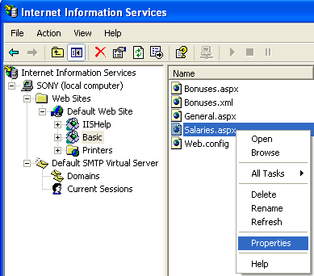
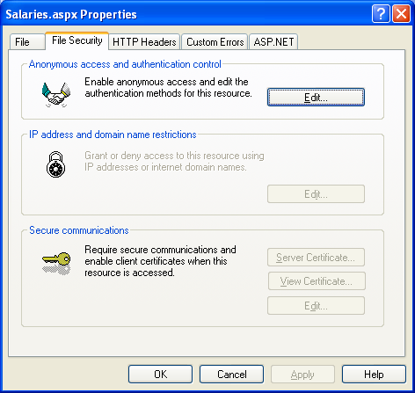
Change the Permission to Basic Security
Right click

Slide 42
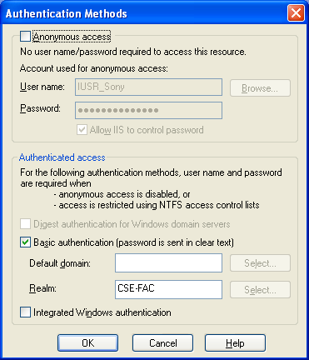
Remove Anonymous access

Slide 43
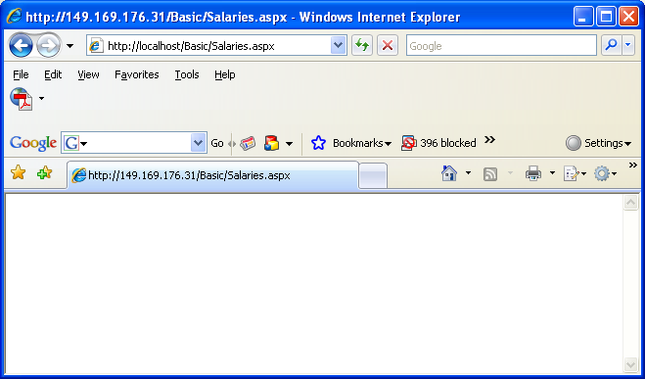


Authenticated Access
Type your windows login name and password

